Slide 1

Team Details
Team name: INNOVA TRIX
Team leader name: J.chandrika
Problem Statement: AI-for-Agriculture-Predicting-Water-Scarcity-and Crop-Failure

Slide 2

Problem statement:
“An AI-powered sensor system that protects crops and saves water by alerting farmers before failure occurs.”
Water Scarcity Prediction
Farmers cannot foresee water scarcity due to invisible soil and groundwater changes. Sudden borewell depletion causes unexpected water stress.
Crop Stress & Failure Detection
Early crop stress from heat and water shortage often goes undetected. This results in sudden yield loss and crop failure.
Farmer Accessibility & Action Gap
Farmers lack simple , real-time tools for irrigation decisions . Delayed action leads to inefficient water use and preventable crop loss.
One-Line Impact Statement :“Turning agricultural data into early warnings—because preventing crop failure is a smarter opportunity than recovering from loss.”

Slide 3
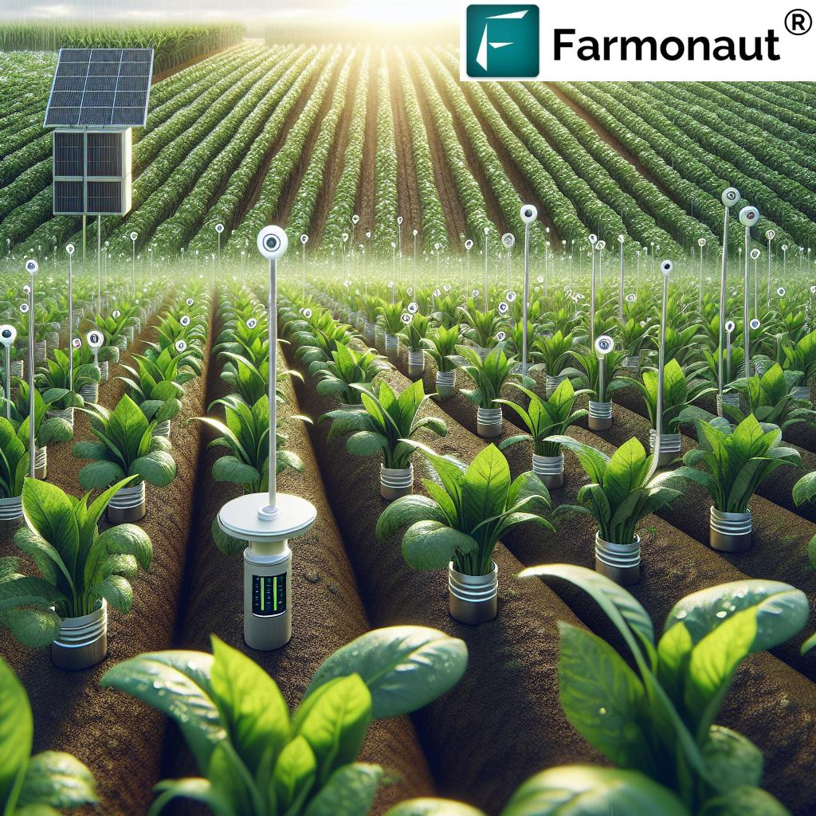
Brief about your solution and problem statement addressing
An AI-powered, solar-driven agriculture monitoring system that integrates soil, groundwater, weather, and crop health sensors to predict water scarcity and crop failure in advance. By analyzing real-time field data along with historical drought patterns and crop requirements, the system identifies early signs of water stress, irrigation insufficiency, and crop health degradation. The solution delivers simple visual and audio alerts to farmers, enabling timely irrigation decisions, efficient water usage, and prevention of sudden crop loss without relying on smartphones or complex interfaces.

Slide 4
Opportunities
a. How different is it from any of the other existing ideas?
Predictive AI: Replacing old statistical averages with machine learning (LSTM/XGBoost) to forecast failures months in advance.
Data Fusion: Combining IoT soil sensors with satellite and drone imagery for precise, plant-level monitoring.
Proactive Precision: Moving from reactive disaster relief to precision irrigation that prevents crop failure before it occurs.
b. How will it be able to solve the problem?
AI Precision: Automated irrigation using IoT sensors to cut water waste by 50%.
Soil Resilience: Regenerative farming (no-till, cover crops) to store 20,000 extra gallons of water per acre.
New Sources: Solar-powered water extraction from air and advanced wastewater recycling for decentralized supply.

Slide 5
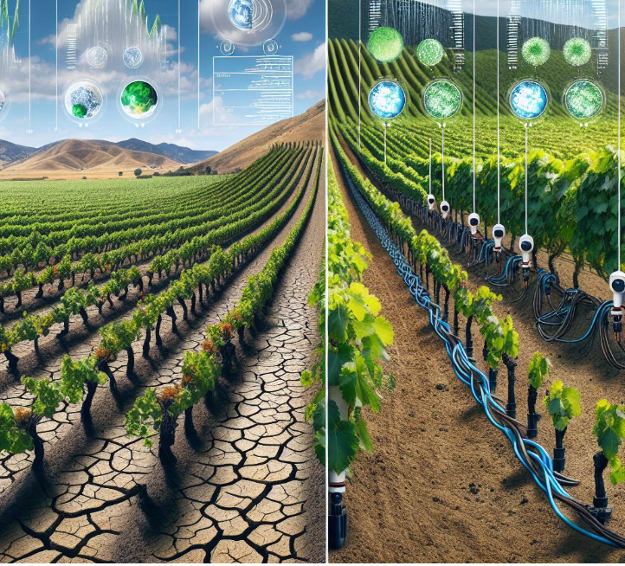
🌱 Real-Time Soil Moisture Monitoring Continuously measures soil water content using field sensors.
🌦 Weather & Rainfall Detection Tracks temperature, humidity, and rainfall conditions affecting crops.
🤖 AI-Based Water Scarcity Prediction Predicts upcoming water shortage based on sensor data patterns.
🌾 Crop Failure Risk Prediction Identifies early signs of crop stress and potential failure.
🚨 Early Warning Alerts Provides alerts using LED indicators and buzzer signals.
🔁 Automatic Irrigation Control Automatically switches irrigation ON/OFF to prevent under or over-watering.
👨‍🌾 Farmer-Friendly Hardware Interface Works without smartphones, apps, or literacy.
⚡ Low-Cost & Energy Efficient Design Suitable for rural deployment, optional solar power support.
🌍 Supports Sustainable Agriculture Saves water, improves yield, and reduces resource wastage.
List of features offered by the solution

Slide 6
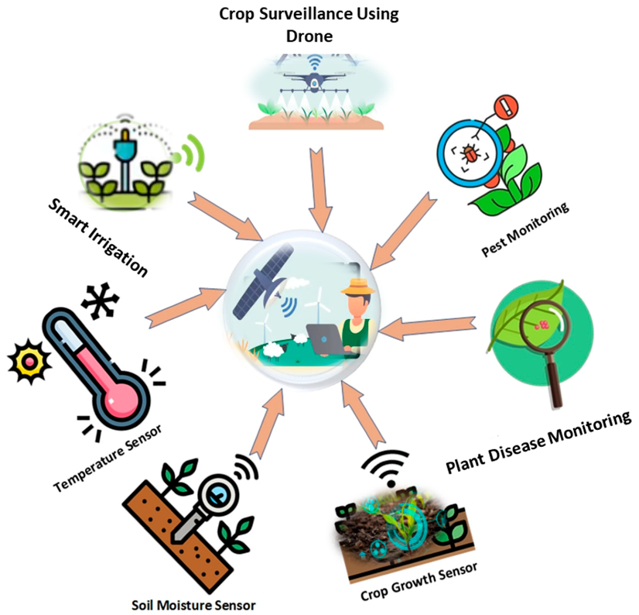
Google Technologies used in the solution
Crop Surveillance Using Drone: Crop surveillance using drones is the use of drones to monit0r crop health, growth, and problems by capturing images and data from the air
Temperature Sensor: A device that measures how hot or cold the environment is.
Soil moisture sensor: A device that measures how much water is present in the soil.
Smart Irrigation: Smart irrigation is the use of technology to water plants only when and how much they need, reducing water waste and improving efficiency.

Slide 7
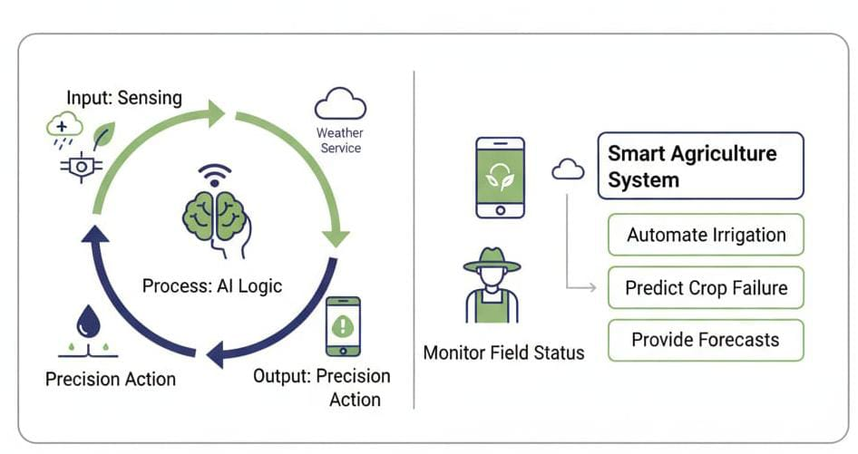
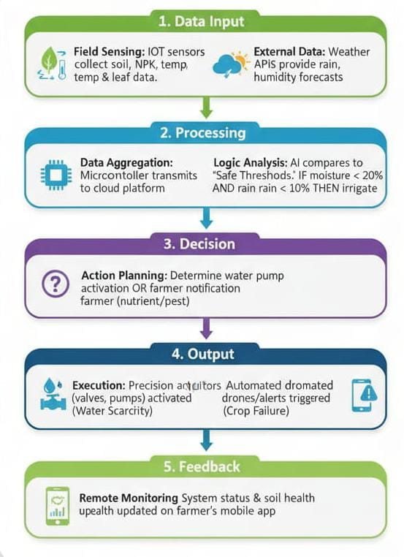
Process flow diagram or Use-case diagram:

Slide 8
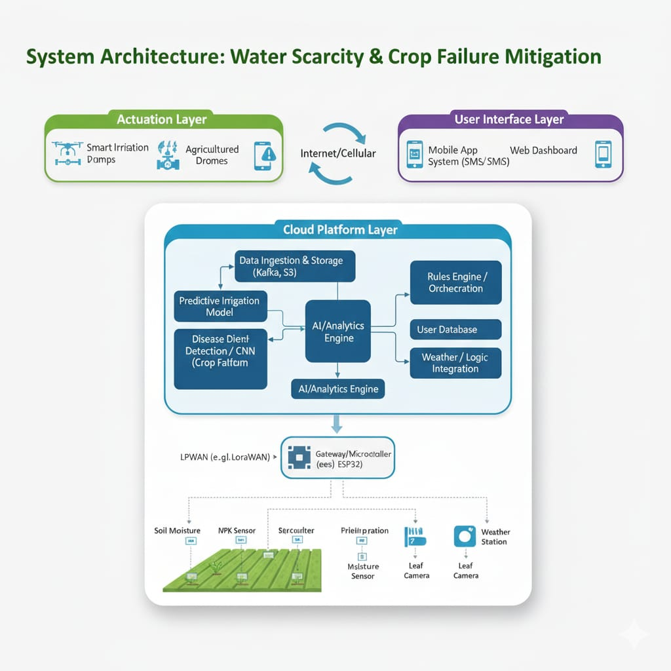
Architecture diagram of the
proposed solution
This system uses IoT sensors in the field to monitor soil moisture, nutrients, and crop health in real-time. This data is transmitted via a Gateway (ESP32) to a Cloud Platform, where an AI Engine analyses it to predict irrigation needs and detect plant diseases. Based on these insights, the system automatically triggers pumps or drones to take action. Finally, farmers receive live updates and alerts through a mobile app, allowing them to manage their crops efficiently from anywhere.

Slide 9
Implementations For Further Development
Solar-Powered Autonomy: Equipping all field sensors and pumps with solar panels to make the farm fully self-sufficient and green.
Satellite Sight: Merging ground sensor data with satellite imagery to monitor crop health across massive areas that drones can't reach.
Leak Detection: Using AI to sense tiny drops in water pressure, instantly stopping leaks before a single gallon is wasted.
Edge Intelligence: Teaching the field cameras to "think" locally so they can detect pests instantly, even without an internet connection.
Smart Weather Fusion: Connecting the system to global climate forecasts to skip irrigation if rain is predicted in the next hour.
Community Sharing: Creating a "Neighborhood Grid" where farmers can trade surplus water or alert each other about spreading diseases.

Slide 10
Additional Ideas
🌱 1. Smart Soil–Water Prediction:
AI uses soil moisture, temperature, and pH sensors to predict water stress early and alerts farmers using simple LED signals.
How it predicts:
Analyzes soil moisture trends over time to forecast upcoming water stress.
Output:
Green LED (Safe), Yellow LED (Stress coming), Red LED + buzzer (Irrigate now).
💧 2. Groundwater Scarcity Prediction Node
Low-cost borewell sensor predicts how many days of groundwater remain using water level trends and rainfall data.
How it predicts:
Calculates groundwater depletion rate using borewell level, rainfall, and usage data.
Output:
Light indicators showing days of water left + optional local voice alert.
🌦 3. Micro-Climate Crop Failure Predictor
A mini weather station with edge AI detects heat stress and dry spells to predict crop failure at field level
How it predicts:
Detects heat stress and rainfall gaps and compares them with crop growth stage using AI.
Output:
LED or symbol indicator showing low, medium, or high crop failure risk.
🌾 4. Leaf-Based Crop Health Monitor
Optical sensors detect early crop stress invisible to humans and predict water-related crop failure weeks ahead.
How it predicts:
Uses optical/NDVI data to identify early plant stress linked to water deficiency.
Output:
✔ Healthy crop / ✖ Stress detected indicator.
.

Slide 11
Provide links to your:
GitHub Public Repository: https: //github.com/chandrikajogi32-art/AI-for-Agriculture-Predicting-Water-Scarcity/blob/main/README.md
Demo Video Link (3 Minutes):
MVP Link:

Slide 12
Thank you!

